Slide 1
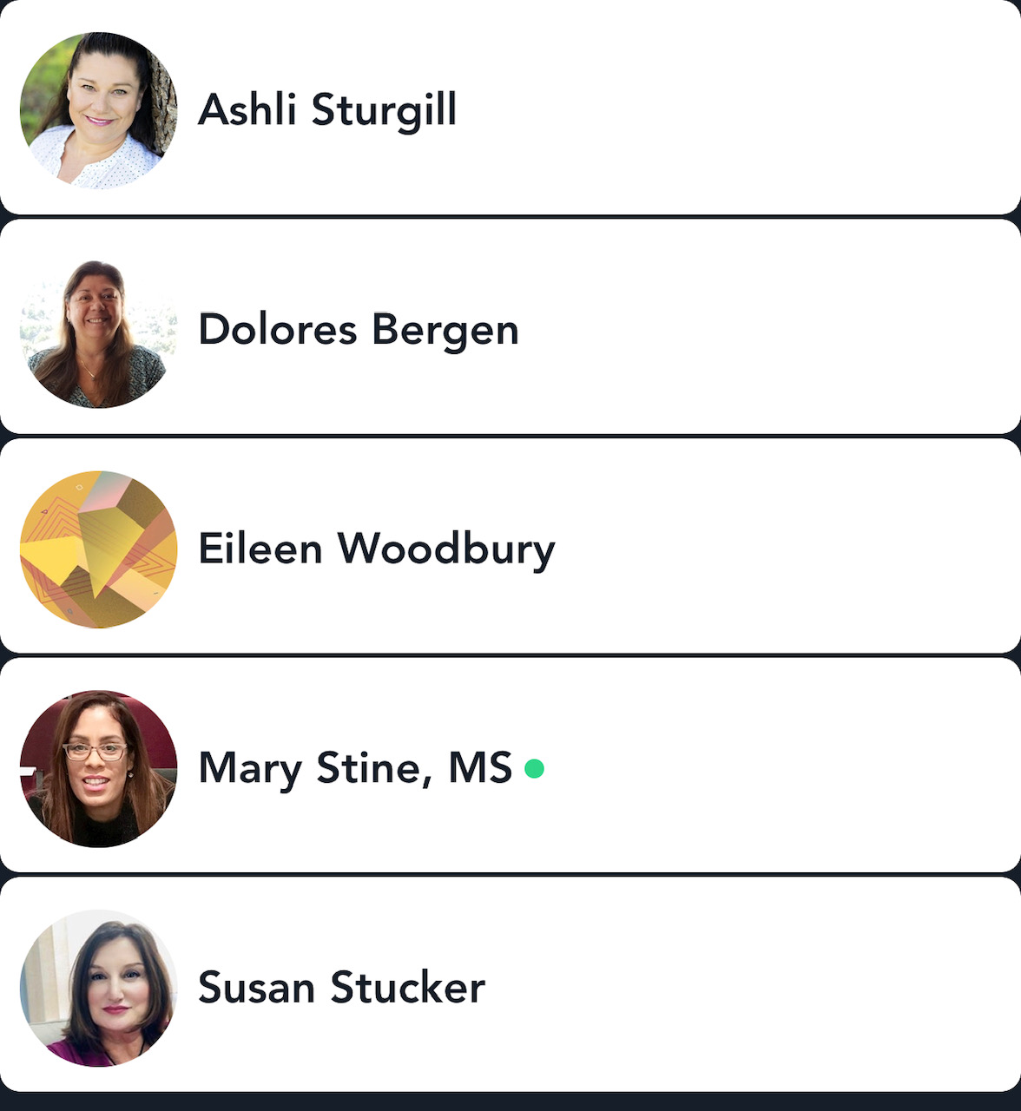
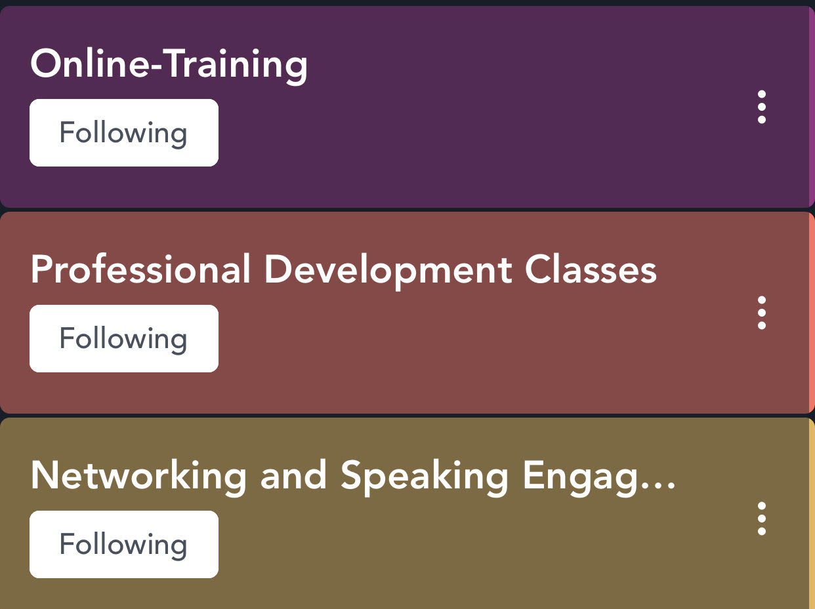
WISE Events Q2-2020
June 22, 2020 15;00 – 19:30 WISE Awards Ceremony and Social Hour
https://cb.webex.com/meet/croll Access Code: 737 086 812
July 28, 2020 12;00 – 13:00 Guest Speaker EHS Burnout and how to prevent it
https://www.Eventbrite.com/e/burned-out-use-curiosity-to-reignite-your-careers-passion-tickets-109889987912
Keep up with all the latest events, seminars and training at The Mighty Networks Greater San Jose CA WISE
https://wise-asp-greater-san-jose-ca.mn.co/share/eod22Ztm4jxxSwhc

